Slide 1
2022 Reach Codes Program
Advancing safer, healthier and more affordable buildings and vehicles
Slide Deck Library for Member Agency Use
CentralCoastReachCodes.org

Slide 2
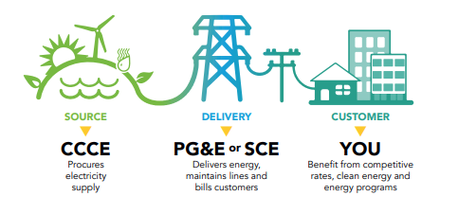
CLEAN ENERGY. LOCAL CONTROL.

Slide 3
Reach Code Pathways
Amendment Type | Governing Agency | Advantage | Disadvantages | Examples
Part 11 (Building Code) | Building Standards Commission (BSC) | CEC approval not required | Tied to the 3-year code cycle | Pacifica
Part 6 (Energy Code) | California Energy Commission (CEC) | Can include energy efficiency measures | CEC approval required | Ojai
Municipal Code | Building Standards Commission (BSC) | Not tied to the 3-year code cycle | Semi-permanent approach favors long-term measures | San Luis Obispo Santa Cruz
Zoning Code (EV only) | Building Standards Commission (BSC) |  |  | San Luis Obispo
Notes:
Historically, most reach codes were amended through Title 24 part 6. Now, there are more options each with their set of advantages, disadvantages and processes
For muni amendments, only need to file with the BSC.

Slide 4
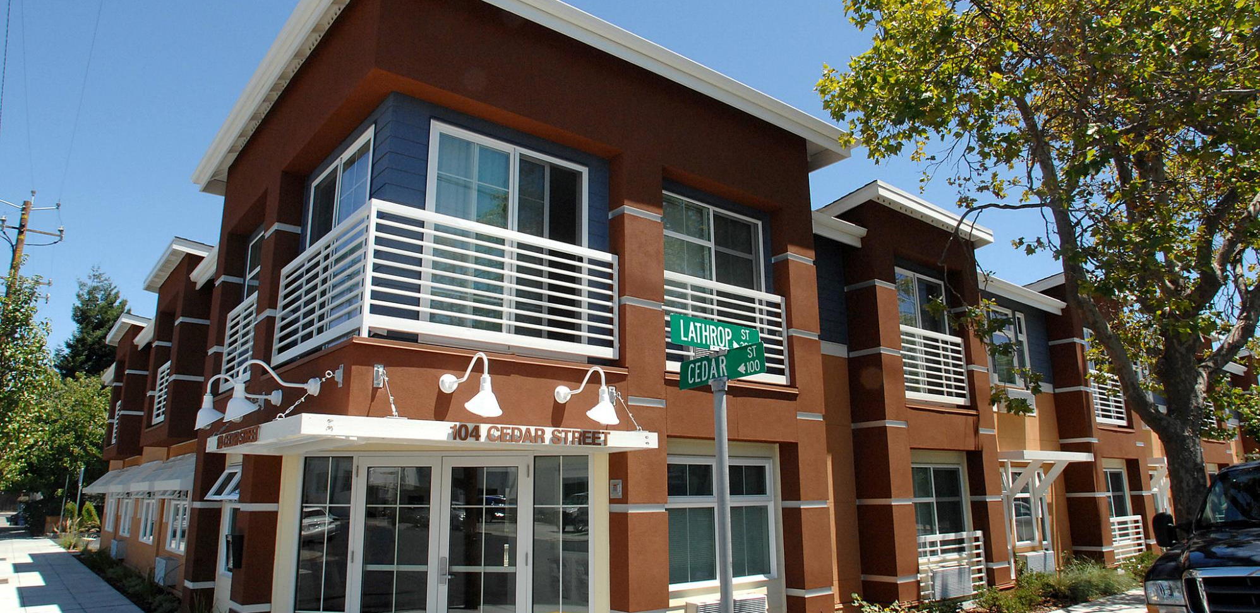
What are Reach Codes?
Local enhancements to state code
Can be adopted at any time
Addresses:
Building electrification – reduced use of methane gas
Electric vehicle (EV) charging infrastructure – increased readiness
Improves economic and energy performance of buildings
Codes are enhanced by stakeholder engagement, why we are here

Slide 5
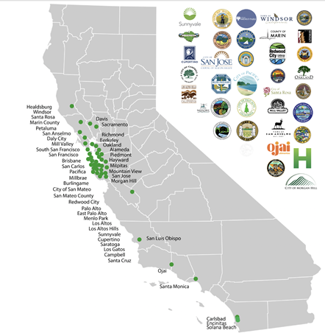
Reach Code Program - Statewide
Over 70 jurisdictions in CA have adopted all-electric reach code ordinances, with some also adopting electric vehicle charging infrastructure reach codes. This includes Santa Cruz’s and San Luis Obispo’s all-electric municipal ordinances.
Visit localenergycodes.com/content/adopted-ordinances for a complete list of reach codes adopted throughout California
Credit: Sierra Club

Slide 6
Reach Code Program – CCCE Region
All-electric new construction
Adopted in July 2022
Municipal amendment through Health and Safety Code
All-electric new construction
Adopted in April 2020
Municipal amendment through Health and Safety code
City of San Luis Obispo
City of Santa Cruz

Slide 7
Reach Code Adoption Process
Stakeholder Engagement (2-6 months)
Council Study Session (TRC presentation)
2nd Council Reading
1st Council Reading
File with CBSC
Code takes effect

Slide 8
Presentation Overview
Topics
Building electrification
Electric vehicle (EV) charging infrastructure
New construction
Alterations
Agenda
Technology and feasibility
Costs
Policy models
Tools and Resources

Slide 9
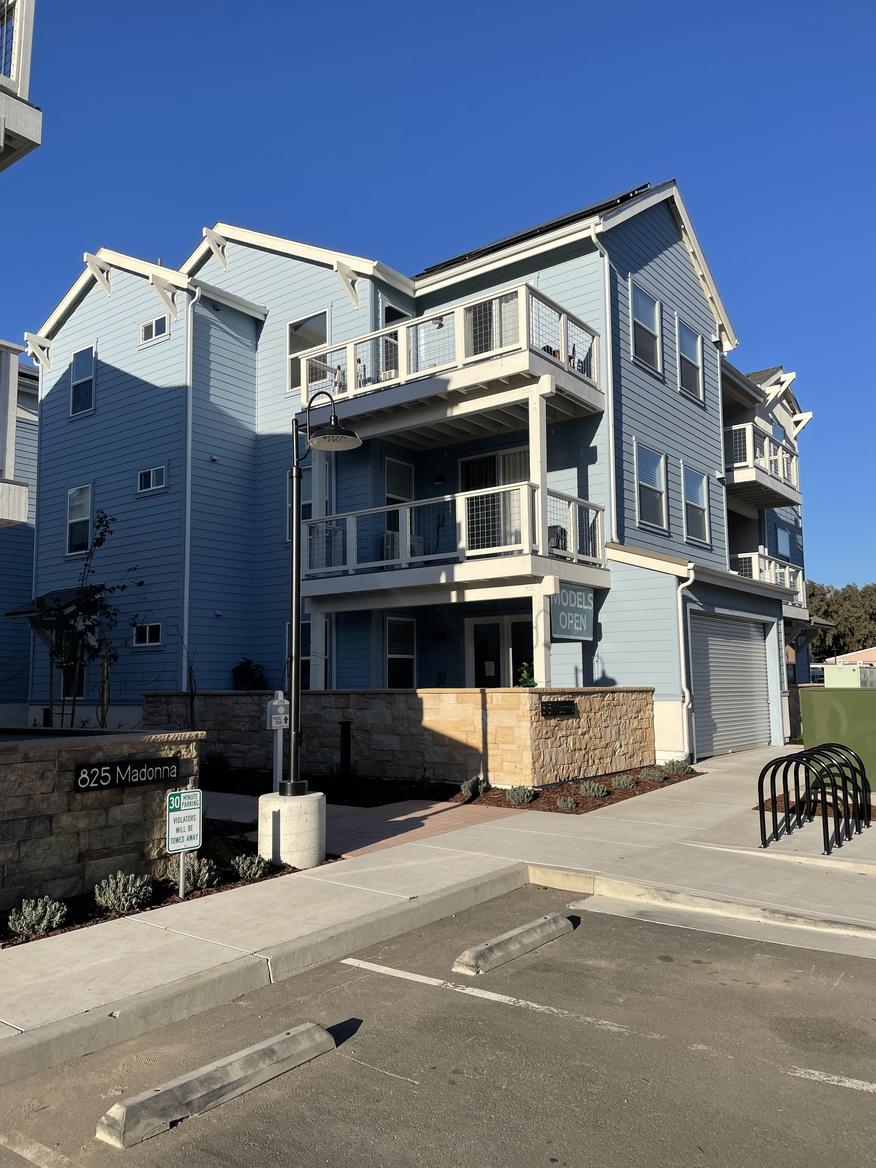
Technology and Feasibility
Source: Rutherford + Chekene

Slide 10
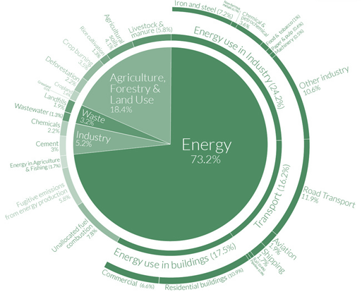
Global Carbon Emissions Sources
18% Commercial & Residential Buildings
12% Road transport
Source: Shayle Kann, Climate Tech VC
In CA, these emissions are overwhelmingly associated with methane gas equipment that can be electrified

Slide 11
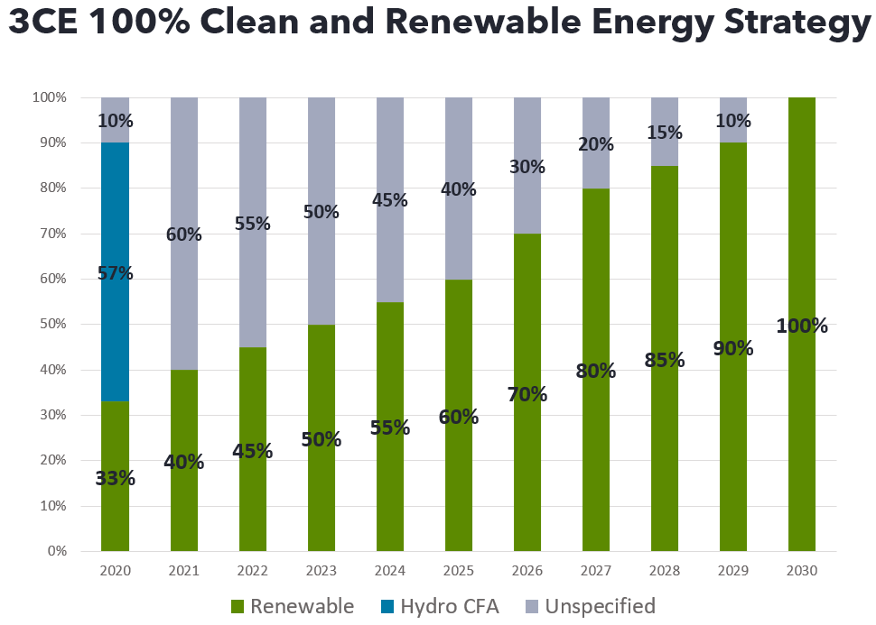
Electrification, Compared to Fossil Fuels
Carbon-free
Lowest-cost, lowest-risk pathway
Healthier indoor air
Job creation
Source: 3CE Power Content July 2022
Notes:
CA Executive Order B-55-18 for Carbon Neutrality by 2045
3CE is on a pathway to supply 100% renewable energy by 2030 and already offer a 100% renewable option through their 3CE Prime package

Slide 12
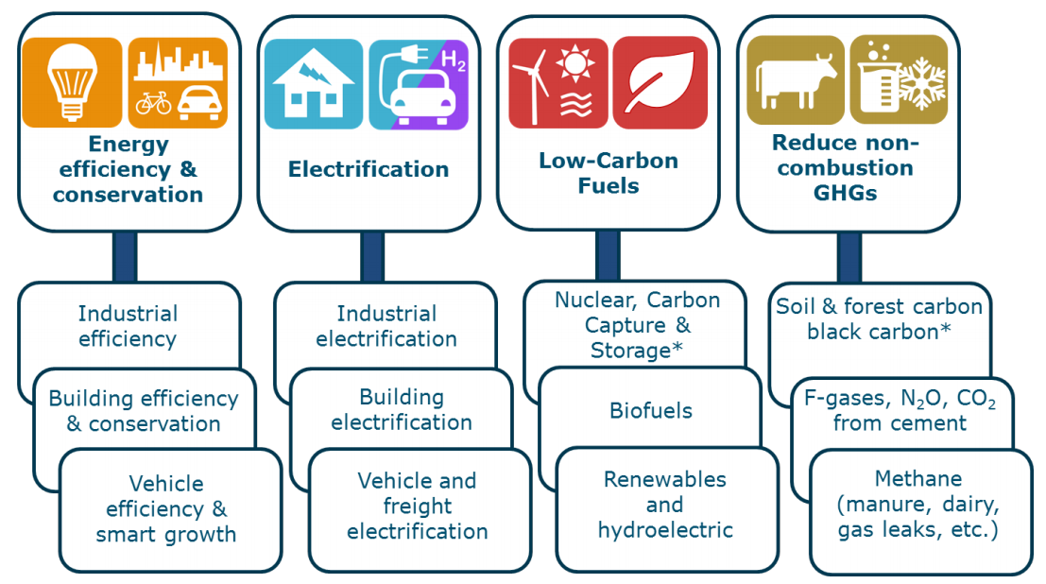
Electrification, Compared to Fossil Fuels
Carbon-free
Lowest-cost, lowest-risk pathway
Healthier indoor air
Job creation
Sources: 1) AB3232 Decarbonization Assessment 2021 2) CA Energy Commission 2018 3) CPUC 2021
Notes:
- Lower-risk pathway according to California Energy Commission.
- Generates substantial cost savings due to avoided new gas infrastructure, and maintenance of existing lines
- Operational costs favoring today’s use of fossil gas will change over time. A November 2021 CPUC Staff Proposal recommends the elimination of gas line extension allowances, refunds, and discounts for new customers, which will impact gas utility rates.

Slide 13
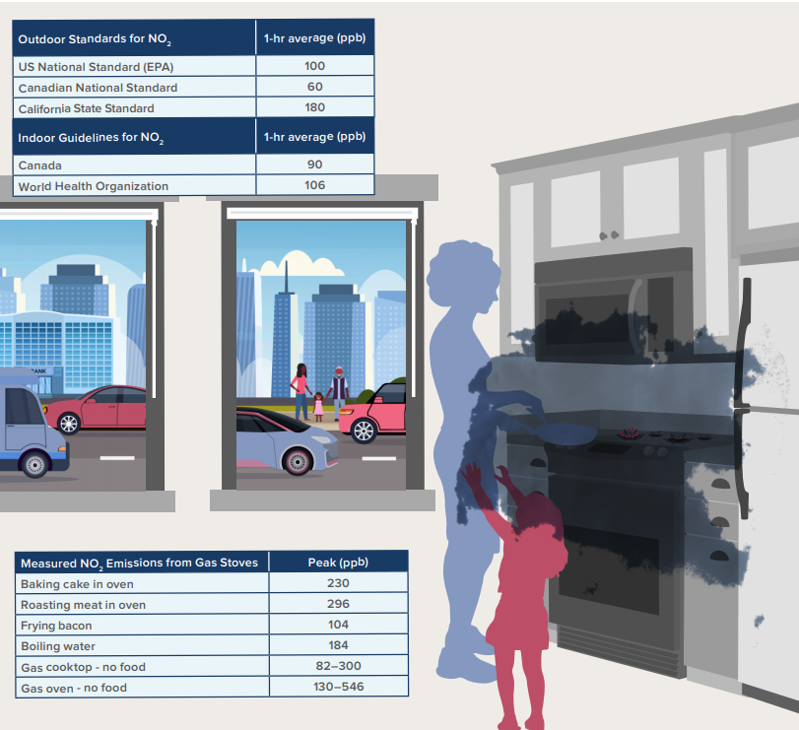
Electrification, Compared to Fossil Fuels
Carbon-free
Lowest-cost, lowest-risk pathway
Healthier indoor air
Job creation
Sources: RMI 2020, CEC 2019
Notes:
Reduced levels of
NO, NO_{X}, NO₂
Formaldehyde
Carbon Monoxide

Slide 14
Electrification, Compared to Fossil Fuels
Carbon-free
Lowest-cost, lowest-risk pathway
Healthier indoor air
Job creation
Sources: UCLA 2019, UMass 2021
Notes:
Studies estimate that job gains far outweigh losses
Furthermore, Newsom’s proposed budget includes nearly $65M for displaced oil and gas workers (well-capping training, early retirement)

Slide 15
California Buildings Gas Usage
Residential
Non-Residential
2009 Residential Appliance Saturation Survey
2006 California Commercial End Use Survey
Notes:
Not focusing on industrial processes (e.g., sterilizing hot water)

Slide 16
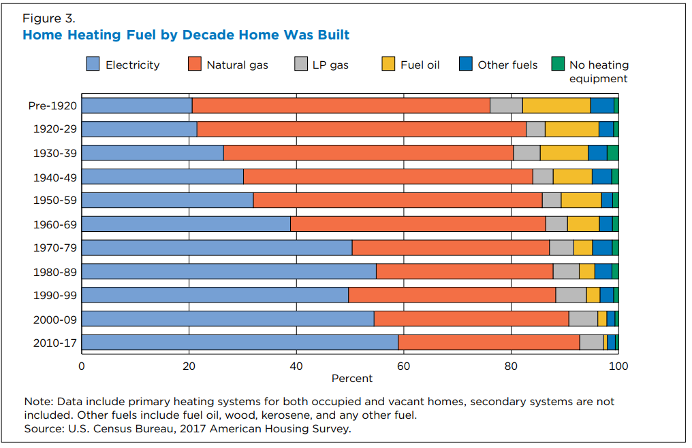
Electric is already the majority
Of national new construction homes:¹
60% use electric space heating (40% of which are heat pumps²)
55% use electric water heating
62% use electric cooking
75% use electric clothes drying
Sources: 1 - 2017 American Community Survey
2 - 2017 IEA Heat Pump Conference Proceedings

Slide 17
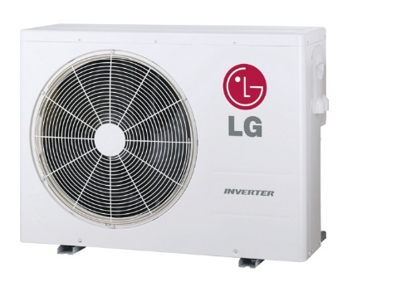
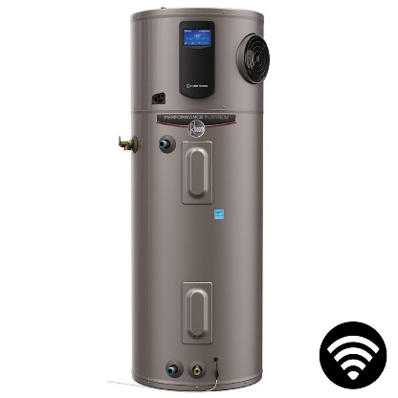
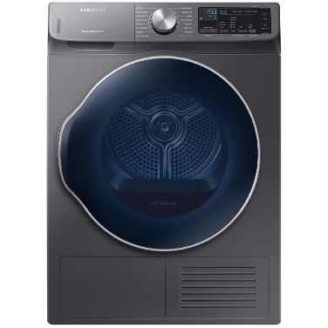
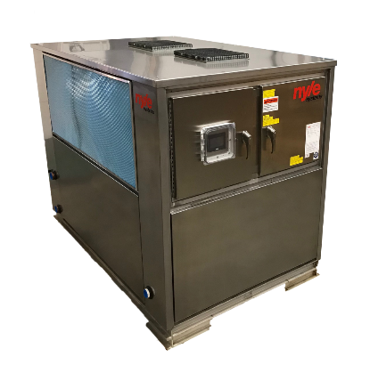
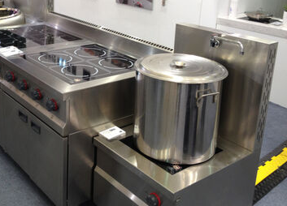
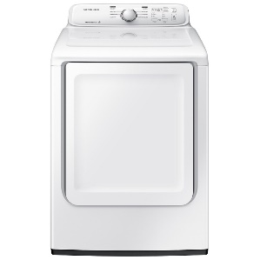
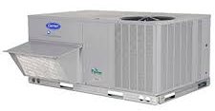
Equipment
Space Heating
Water Heating
Cooking
Clothes Drying
Residential
Commercial

Slide 18
Equipment Efficiency
Space heating,
Water heating,
Clothes drying
Cooking,
High-Intensity Industrial Processes
Notes:
Heat pumps make up a lot of the operational cost difference from having chearper gas than electricity.

Slide 19
All-Electric Home Cost Effectiveness
Mixed-Fuel Home
All-Electric Standard: minimal efficiency, minimal solar
All-Electric Efficient: expanded efficiency, optimal Solar
Construction Cost:
(compared to mixed-fuel)
-
$6,000
savings
$1,000
savings
Bill Impact:
(compared to mixed-fuel)
-
$17/month increase
$50/month savings
CO₂ Impact:
*This analysis was performed for climate zone 5

Slide 20
Results: Details
Mixed-Fuel Home
All-Electric Efficient
All-Electric Standard
Space Heating/Cooling:
Heat Pump
High-Efficiency Heat Pump
Heat Pump
Water Heating:
Natural Gas Tankless
HPWH
HPWH
Cooking:
Natural Gas
Electric Resistance
Electric Resistance
Ceiling / Window Insulation:
R-30 / U=0.3
R-49 / U=0.24
R-30 / U=0.3
Ductwork Pressure:
Standard (0.45 W/CFM)
Low (0.30 W/CFM)
Standard
PV System:
2.9 kW
5.7 kW
2.9 kW

Slide 21
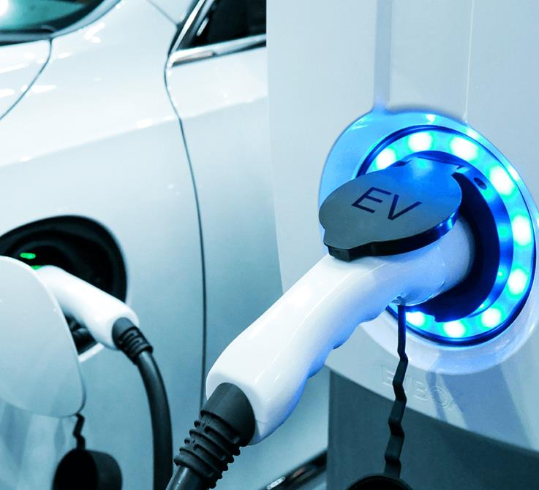
EV Charging Need and Technology

Slide 22
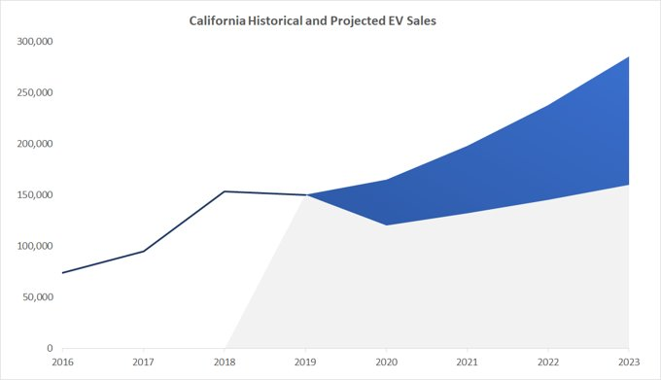
EV Charging Demand
Increase in light-duty EV ownership
250,000 EVs sold in 2021, 12.5% of all vehicles
EV sales increase 56% from 2019 to 2021 compared to 4% for all vehicle sales in CCCE service area
Costs of Sale of gas vehicles phased out by 2035
Pervasive issues
Electrical upgrades
Underserved multi-family housing occupants
Sources: California Energy Commission, EO N-79-20

Slide 23
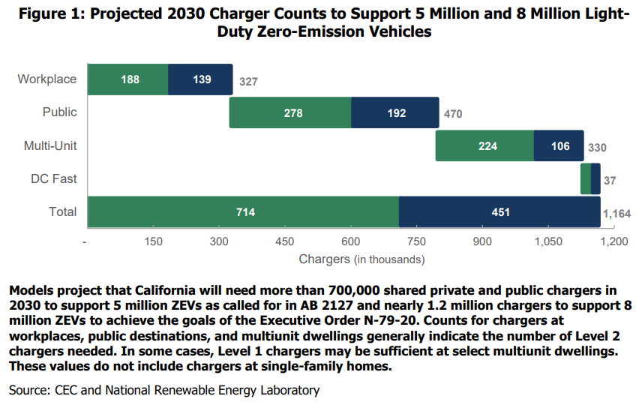
EV Charging Demand
AB2127 Requirements by 2030
CARB Estimates for 2030
Source: CEC and NREL, AB2127 (2021)
Notes:
“A public charging station has parking space(s) designated by a property owner or lessee to be available to and accessible by the public for any period.”​

Slide 24
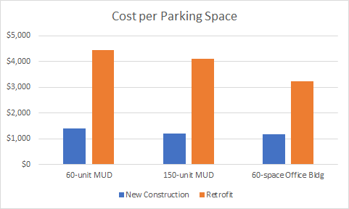
Cost-Benefit - Building
Retrofit costs shown are “best case”
Retrofit can be much higher
PG&E retrofit 'cost-per-port’ ave. is $18,000
Costs include wiring, switch gear, conduit, trenching, and secondary transformer
Sources: 1) Electric Vehicle Infrastructure Cost Analysis for PCE and SVCE 2) Pacific Gas and Electric Company EV Charge Network Quarterly Report, Q2 2020
Notes:
Costs were developed for PCE and SVCE but trends are representative of the state

Slide 25
Automatic Load Management
1 car charging
7.2kW
2 cars charging
3.6kW
3.6kW
4 cars charging
1.8kW
1.8kW
1.8kW
1.8kW
Notes:
This illustration is one approach among several ALMS approaches

Slide 26
2022 Reach Code Policy Models
2022 California Energy Code
Reach codes
Building electrification
Electric Vehicle infrastructure
Discussion

Slide 27
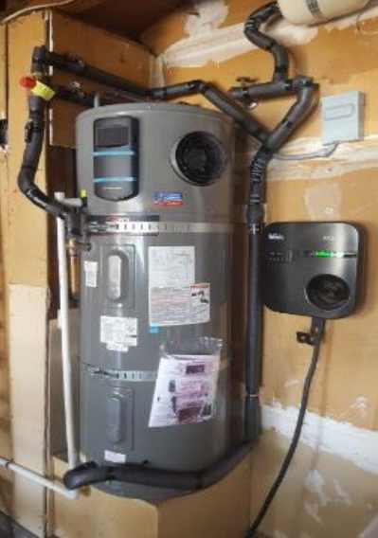
2022 CA Energy Code
New Construction
Existing Buildings
Heat pumps are prescriptive baseline
Residential
Space heating in climate zone 3, 4
Water heating in climate zone 12
Nonresidential – water- and/or space-heating for most building types
Performance credit for all-electric design
Residential
Pre-wiring required for gas appliances
Higher ventilation rate for gas stoves
Energy storage readiness
Nonresidential - Solar PV and Battery Storage prescriptive
Restricts newly installed electric resistance heating
Simplified language for heat pump retrofits

Slide 28
Building Electrification – New Construction
2022 Program - Key Concepts
All-electric construction required
Optional exceptions
Infeasible to construct according to CA Energy Code
Restaurants
Electric-readiness required
New construction definition
If either of the below are replaced over 3 years for purposes other than repair or reinforcement
50% of foundation
50% of above-sill framing, or
Pre-wiring
Physical space
Also restricts extension of any existing gas infrastructure
3CE offers incentives for all-electric new construction
Find our codes on:
CentralCoastReachCodes.Org

Slide 29
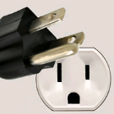
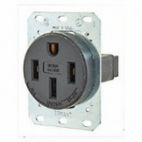
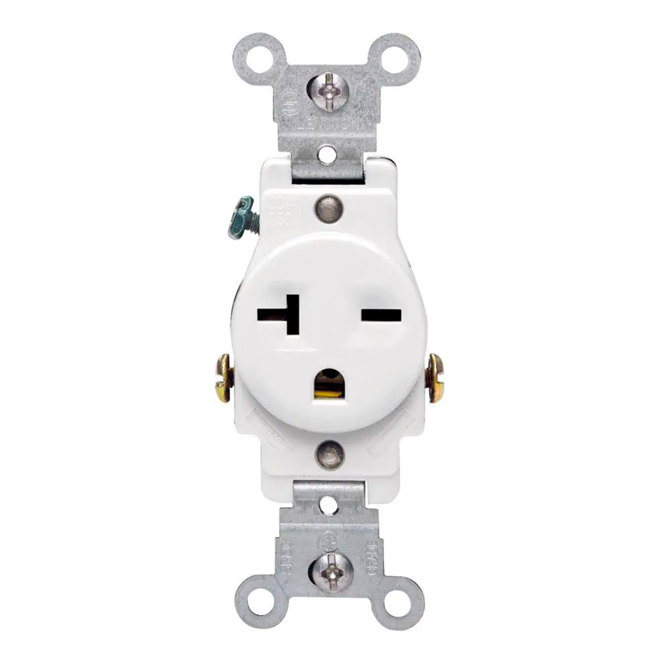
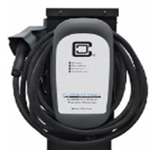
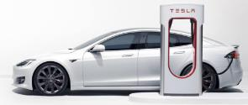
EV Code Terminology
Speed
Readiness
Number
EV Capable
Level 1
3-4 miles per charging hour
Percent of Parking Spaces
EV Ready
Level 2
10-20 miles per charging hour
Level 3
150+ miles per charging hour
EV Charging Station
Notes:
L1 provides nearly 50 miles of range with an overnight charge (3-4 miles for 12 hours) good for most daily vehicle use.

Slide 30
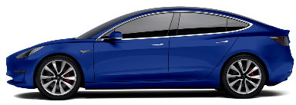
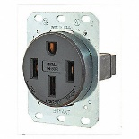
EV Infrastructure – New Construction
2022 Program - Key Concepts
 | 2019 CALGreen | 2022 CALGreen | Model Code
 | Mandatory | Mandatory
Single Family Homes and Two-Family Townhomes | (1) Level 2 EV Capable for one parking space per dwelling unit |  | 2 EV spaces total: 1 Level 2 EV Ready circuit 1 Level 1 EV Ready circuit
ELECTRIC
VEHICLE
OUTLET
3CE offers incentives through the electrify-your-ride program for EVs, chargers and electrical infrastructure

Slide 31
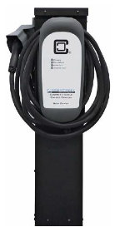
EV Infrastructure – New Construction
2022 Program - Key Concepts
 | 2019 CALGreen | 2022 CALGreen | Model code
 | Mandatory | Mandatory
Multi-Family
AUTOMATIC LOAD MANAGEMENT ENCOURAGED
% of Parking Spaces
% of Dwelling Units with Parking Spaces
10%
5%
25%
40%
15%
10%
60%
85%
5% Level 2 EVCS
25% Level 2 EV Ready (low-power)
10% Level 2 EV Capable
10% Level 2 EV Capable
Low Power Option
40% Level 2 EVCS
60% L1 EV Ready
High Power Option
15% Level 2 EVCS
85% L2 EV Ready (low-power)
3CE offers incentives through the electrify-your-ride program for EVs, chargers and electrical infrastructure
Notes:
Make clear that load management is explicitly allowed/encouraged in the model code

Slide 32
100% Access is Cost Comparable
Each scenario is 0.3 – 0.5% of construction cost
Assumes $392/ft2 to build per: Turner and Townsend, 2021
% of dwellings with access
100%
40-60%
100%
100%
Low Power Option
High Power Option

Slide 33
EV Infrastructure – New Construction
2022 Program - Key Concepts
 | 2019 CALGreen | 2022 CALGreen | Model Code
 | Mandatory | Mandatory
Non-Residential
5%
10%
15%
20%
10%
30%
Offices:
20% Level 2 EVCS
30% Level 2 EV Capable
All other:
10% Level 2 EVCS
10% Level 2 EV Capable
6% Level 2 EV Capable
5% Level 2 EVCS
15% Level 2 EV Capable
3CE offers incentives through the electrify-your-ride program for EVs, chargers and electrical infrastructure

Slide 34
EV Infrastructure – Existing Buildings
2022 Program - Key Concepts
Alterations or additions
Single Family – Parking additions or electrical panel upgrades must meet new construction requirements
Multifamily →
Nonresidential →
Time certain policy (Zoning Code only)
By January 1st, 2025, multifamily and nonresidential properties shall upgrade existing EV Capable spaces required by the locally adopted codes at the time the building was permitted to a minimum of Level 1 EV Ready.
When new parking facilities are added, or electrical systems or lighting of existing parking facilities are added/altered and the work requires a permit:
10% of the total number of parking spaces added or altered shall be EVCS.
All existing EV Capable on-site shall be upgraded to minimum L1 EV Ready

Slide 35
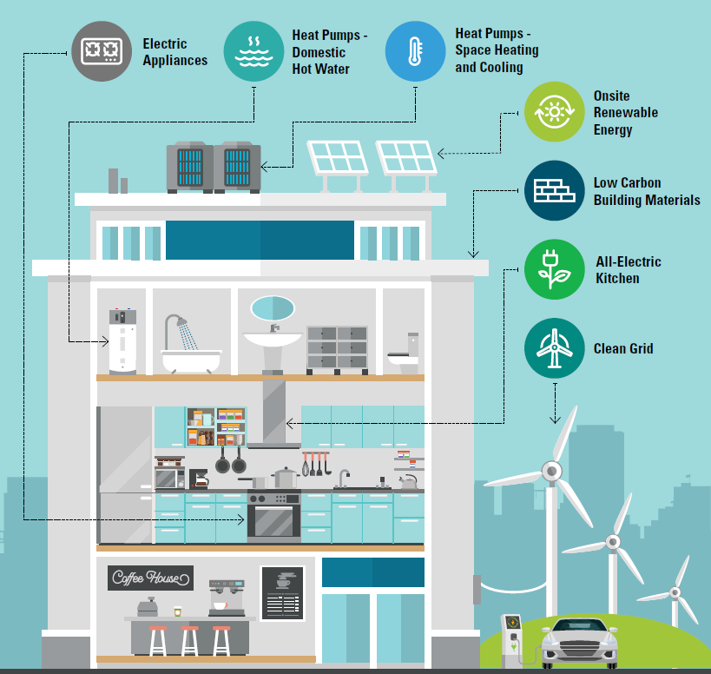
Industry Resources
Building Electrification Technology Roadmap - Covers the technical capabilities of a variety of end-uses
Building Decarbonization Practice Guide Guides architects and engineers towards best practices during design development
Ecosizer Guides engineers and energy consultants for proper design of central heat pump water heating systems
Notes:
Regional public meetings for efficiency and for ‘strength in numbers.’
Permit simplification:
Share state-mandated expedited review requirements and resources
Share city staff trainings for electrification technologies
Develop application resources specifically for electrification projects

Slide 36
EV Charging Incentives
Property Type | Incentive Type | Base Incentive | Incentive Cap
Single Family (New and Existing) | L2 Charger | $400 | $700 <200% Federal Poverty Level
 | EV Readiness | Up to $2,000 | $4,000 <200% Federal Poverty Level
Multifamily (New and Existing) | L2 Charger | - | $10,000
 | EV Readiness | - | $10,000
Commercial (New and Existing) | L2 Charger | 75% of equipment cost | $3,000
 | EV Readiness | 75% of materials and labor cost | $5,000
Source: Electrify Your Ride Residential and Commercial

Slide 37
Thank you! Next Meetings:
Visit us at: centralcoastreachcodes.org

Slide 38
Common Concerns (1 of 2)
Concern | Response
Distribution grid upgrades are expensive | Sometimes true. Costs are offset by savings of all-electric construction.
Resilience, power-shutoffs | Real problem, but gas does not help. Gas appliance ignition is electric. In emergencies gas is also shut-off. State policy for grid hardening is key.
Uniformity | Fair Concern, but all-electric is simpler & not adopting ensures future risk. 3CE and regional partners are encouraging consistency. All-electric is simple and inaction locks in future cost (retrofits, rates) and risk (fire).
In multifamily, central heat pump water heating requires more design expertise and space than gas boilers. | True, training needed. There are scores of working systems, but best practice guidance is available.

Slide 39
Common Concerns (2 of 2)
Concern | Response
All-Electric heating uses too much energy or can’t work in our cool climate | False. All-electric heat pumps are highly efficient and effective in weather far colder than ours. DOE studies show heat pump space heaters as highly efficient at as little as 5 degrees Fahrenheit.
Energy is not clean | False. CCCE is committed to providing 60% clean and renewable electricity by 2025 and 100% by 2030. In 2021, CCCE's power mix included 33.6% clean and renewable energy.
Equipment is not available | Mostly false. Some scenarios for high-volume or steam applications are more challenging to address. Heat pumps and induction stoves have a long-established history, are widely adopted in other states, but market awareness needs to grow. PCE is addressing training needs.
Notes:
Heat pumps use too much energy or can’t work in our cool climate:
Heat pumps are highly effective in weather far colder than ours. DOE’s National Renewable Energy Lab, in an authoritative 2017 study (link, p.42), cites heat pump space heaters with operating effectiveness at 5 degrees Fahrenheit with a “coefficient of performance” of 3 – which is to say it generates 3x the heat for unit of energy input (heat pumps are essentially refrigerators or AC units in reverse). This is consistent with the California Energy Commissions cost effectiveness studies.

Slide 40
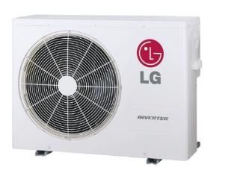
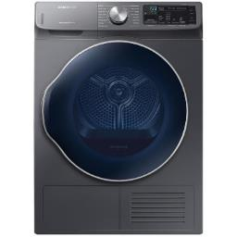
Will Electrification Reduce Resilience?
Heat Pump Space Heating
Heat Pump Water Heating
Induction Cooking
Electric Clothes Drying
Gas furnaces require electric fans, but fireplaces still work.
Gas water heaters require electronic ignition or pumps
Gas stoves will work without electricity, but it’s unsafe
Gas dryers use electric motors to run tumbler
Notes:
Docket – 19-IEPR-01

Slide 41
Can the Grid Handle the Load Increase?
Reliability is mostly a concern during summer peak cooling times. Increases in cooling demand are primarily due to climate change increasing summer temperatures.
California Energy Commission’s AB3232 analysis indicates that aggressive electrification will result in 20 percent additional summer peak load through 2030. Winter load expected match summer peak load.*
All-electric technologies can draw power flexibly. Electric vehicles can charge during off-peak periods, water heating tanks can increase temperature ahead of peak periods, thermostat setbacks can reduce space conditioning demand, and several other approaches will avoid power outages.
Sources: 1) AB3232 Decarbonization Assessment 2021

Slide 42
Will the Grid be Reliable?
CEC has noted electrification as the lower cost, lower risk approach to decarbonization.
CA-ISO has performed a 20-year study and has recommended over $30B in transmission investments to account for increased renewables and decommissioned gas power plants.
Utility-scale battery power output increased 27-fold during heatwaves from August 2020 to August 2022. Having diversity in electrical power sources has already improved grid performance.
The electricity suppliers have a service obligation to meet your needs. “PG&E fully expects to meet the needs that all-electric buildings will require” -Robert S. Kenney, Vice President, PG&E
PG&E has committed to moving 10k miles of power lines underground which will reduce wildfires and power outages.
The elimination of state gas subsidies will free up funding for grid hardening efforts.
Sources: 1) CA Energy Commission 2018 2) CA-ISO 3) LA Times 4)KCRA 5) CPUC R1901011 2022

Slide 43
Why Adopt a Reach Code if CA is Going All-Electric?
Save retrofitting costs in the future. (CARB announced ban on gas furnaces and water heaters by 2030).
We don’t know if or when state will pass an all-electric requirement.
There are additional GHG emission savings if we electrify now.
Local reach code ordinances influence state code.
Improve indoor air quality now.

Slide 44
2019 Reach Code Program - Litigation
Berkeley – Municipal all-electric ordinance: Federal court rejected the plaintiff challenge because the ordinance does not directly regulate either energy use or energy efficiency of covered appliances. Plaintiff has appealed.
Windsor – Energy Code (Part 6) amendment: Agency repealed reach code because the Town could not sufficiently fund legal defense of all-electric reach code.
Santa Rosa – Energy Code (Part 6) amendment: CA court rejected plaintiffs claims regarding CEQA analysis for all-electric reach code. Plaintiff has appealed.
Takeaway: Pending appeals, both a municipal code or building code amendment seem legally defensible.
Source: Climate Case Charts

Slide 45
Building Electrification – Existing Buildings
2022 Program - Key Concepts
Our Approach →
Summarize codes and development processes
Financing strategy
Policy considerations
Develop code for “low-hanging fruit”
Statewide Utility Program
BayREN Policy Calculator
Building stock assessment
Point of permit
Building performance standards
Point of sale
Prioritize
Cost-effectiveness studies
Electric-preferred retrofit ordinance
Air-conditioning installations, new pool permits
“End of flow” date
Reference useful tools
Stakeholder engagement
3CE offers incentives for existing buildings

Slide 46
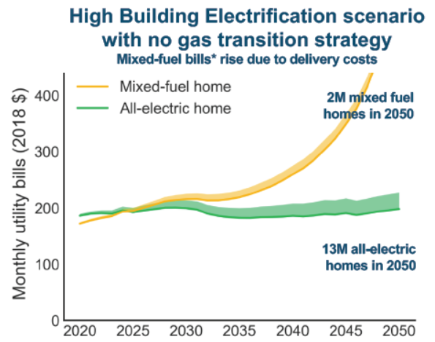
Natural Gas Costs Climbing
CA residential natural gas prices increased 3x faster than electricity prices from 2012 to 2018
Trend expected to accelerate:
Source: EIA https://www.eia.gov/dnav/ng/hist/n3010ca3m.htm https://www.eia.gov/electricity/data/browser/#/topic/7?agg=2,0,1&geo=g&freq=M
CEC Workshop June 6, 2019: Draft Results from E3 study on the Future of Natural Gas Distribution in California
The AB3232 Report represents the most current CEC research supporting that Aggressive Electrification is the primary pathway to meeting GHG reduction targets.
Notes:
CEC studies repeatedly show High Electrification must happen to meet GHG reduction targets. This is the direction that the state is going.
We expect gas prices to rise faster long-term, though the increase will be asymptotic without a gas transition strategy.

Slide 47
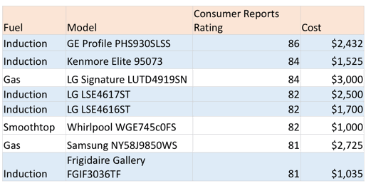
Stoves: Consumer Reports Prefers Induction
6 of top 8 Ranges for 2020 were electric, top 2 were Induction

Slide 48
Biogas Can’t Get Us There

Slide 49
Notes:
https://drscleanup.com/2017/10/house-fire-causes-be-safe/
https://www.nfpa.org/News-and-Research/Data-research-and-tools/Building-and-Life-Safety/Home-Structure-Fires

Slide 50
Federal Policy: Inflation Reduction Act
Inflation Reduction Act includes $369 billion in clean energy & climate.
Solar
Extension of Investment Tax Credit (ITC) – 30% with prevailing wage, storage added
Direct pay option allows government agencies to secure ITC directly
Electric Vehicles
Continuation of $7,500 tax credit for new vehicles
Vehicle cost up to $55k for cars and $80k for SUVs and trucks, lifting the manufacturer's cap, families earning under $300k/yr
$4,000 tax credit for used electric vehicle
Cost up to $25k, families earning under $150k/yr
Buildings
$4.5B for up to $14,000 in rebates for electric appliances
up to 50% of costs for moderate-income households and 100% for low-income households.
$8,000 for heat pump HVAC, $1,750 for water heaters, $840 induction cooktop, $840 heat pump dryer, up to $9,100 for panels, wiring, insulation
Tax credits up to $2,000 for heat pumps
Energy efficiency up to 50% whole home retrofit or >80% for low/moderate income
Notes:
https://www.americanprogress.org/article/5-major-benefits-of-the-inflation-reduction-acts-climate-investments/
https://www.natlawreview.com/article/inflation-reduction-act-includes-expansive-tax-incentives-clean-energy-investors-and
1. Extension of ITC that start construction before 1/1/2025. 30% but must satisfy prevailing wage and apprenticeship requirements to claim the full credit. Otherwise, the credit rate is 20 percent of the full rate (6%). Full rate applies until 60 days after the Secretary publishes regulations
2. Continuation of $7,500 tax credit for new vehicles, lifting the manufacturer's cap for families <$300k/yr, New EV tax credit has an MSRP cut off of $55k for cars and $80k for SUVs and trucks (cuts out a bunch of Tesla sales. )
3. $4,000 tax credit toward the purchase of a used electric vehicle for families earning under $150,000 per year Used EV tax credit has a cut off of $25k
4. 30 percent off the cost of rooftop solar and batteries
5. $4.5B for up to $14,000 in rebates to switch over to electric appliances—up to 50% of costs for moderate-income households and 100% for low-income households.
○ $8,000 for a heat pump, which serves as an air conditioner in the summer and heater in the winter
○ $1,750 for a high-efficiency, all-electric heat pump water heater
○ $840 for an electric induction cooktop
○ $840 for a high-efficiency all-electric heat pump clothes dryer
○ Up to $9,100 for enabling improvements to the electric panel, wiring, and home insulation
EE up to 50% whole home retrofit or >80% for LMI

Slide 51
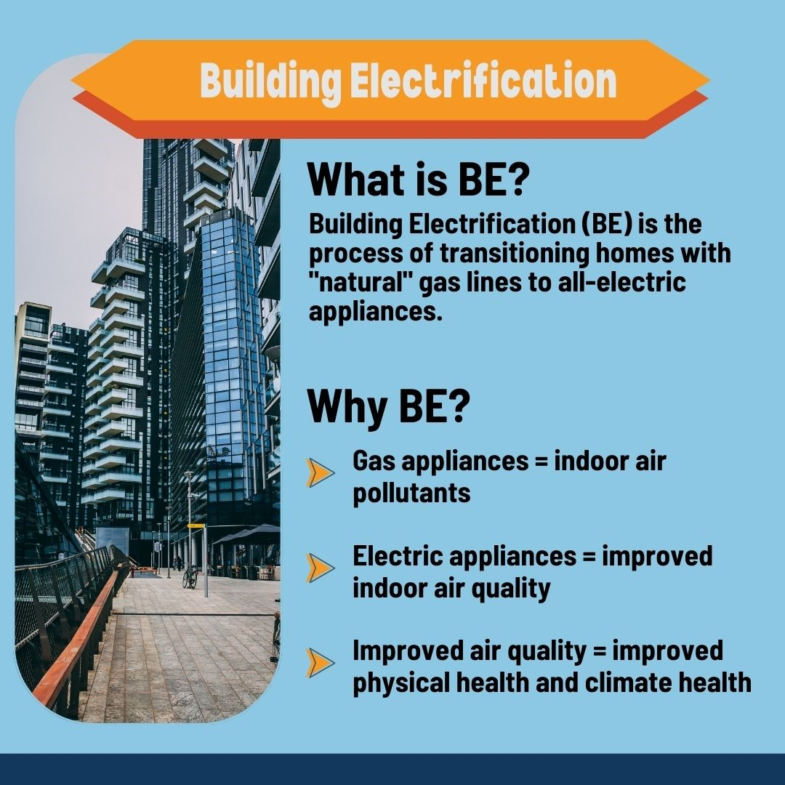
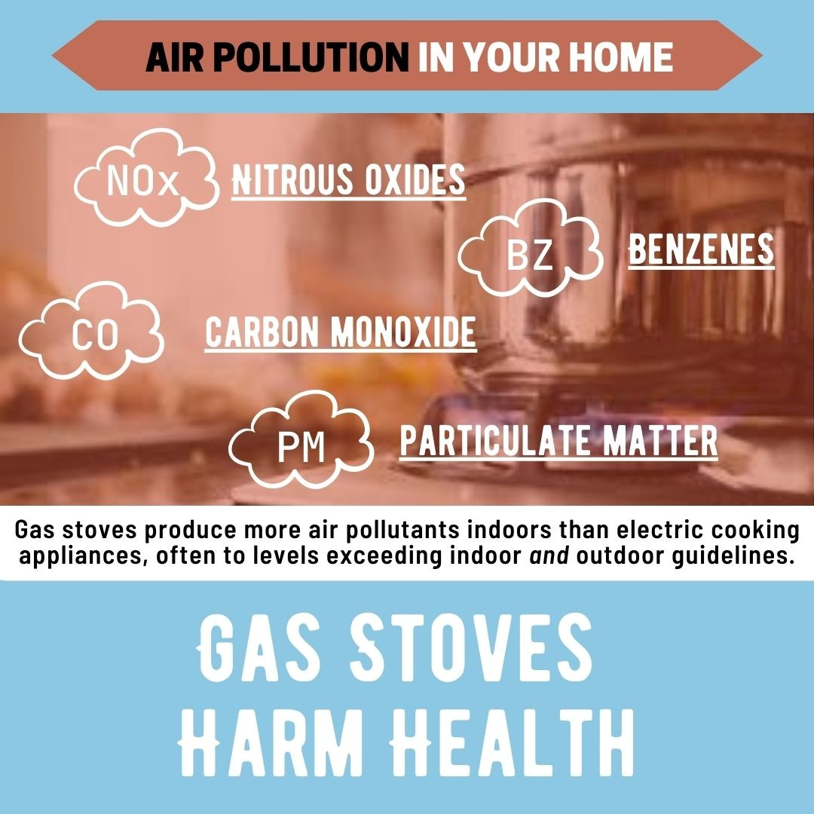
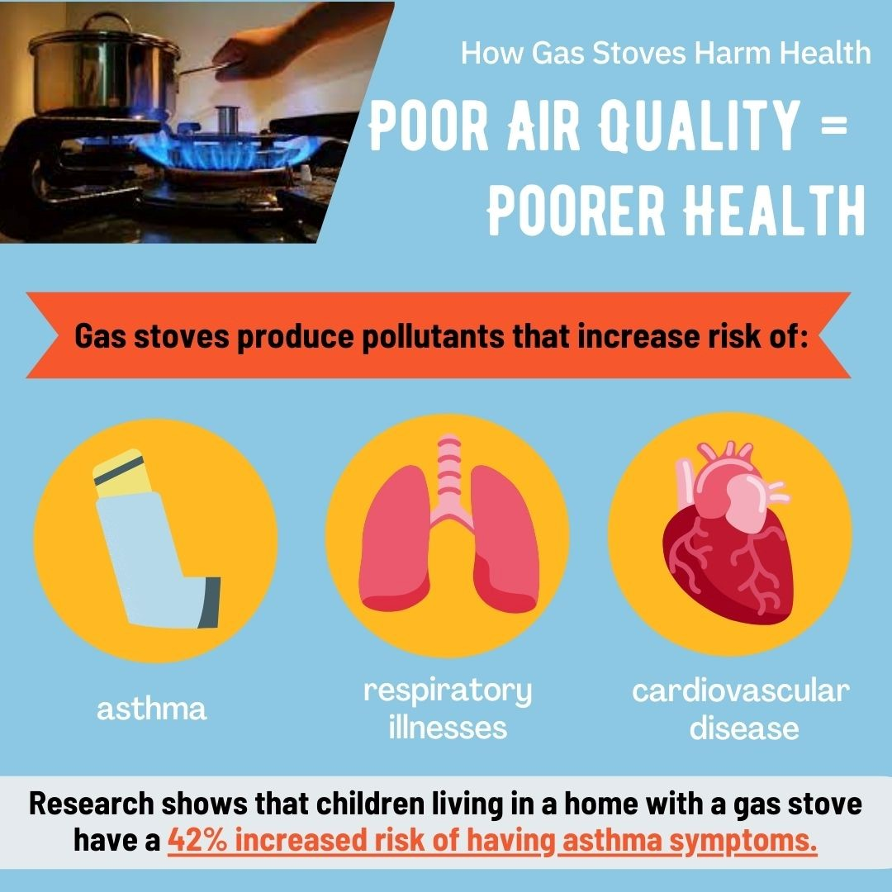
The Health Harms of Gas Stoves
Learn more: www.sfbaypsr.org/BE

Slide 52
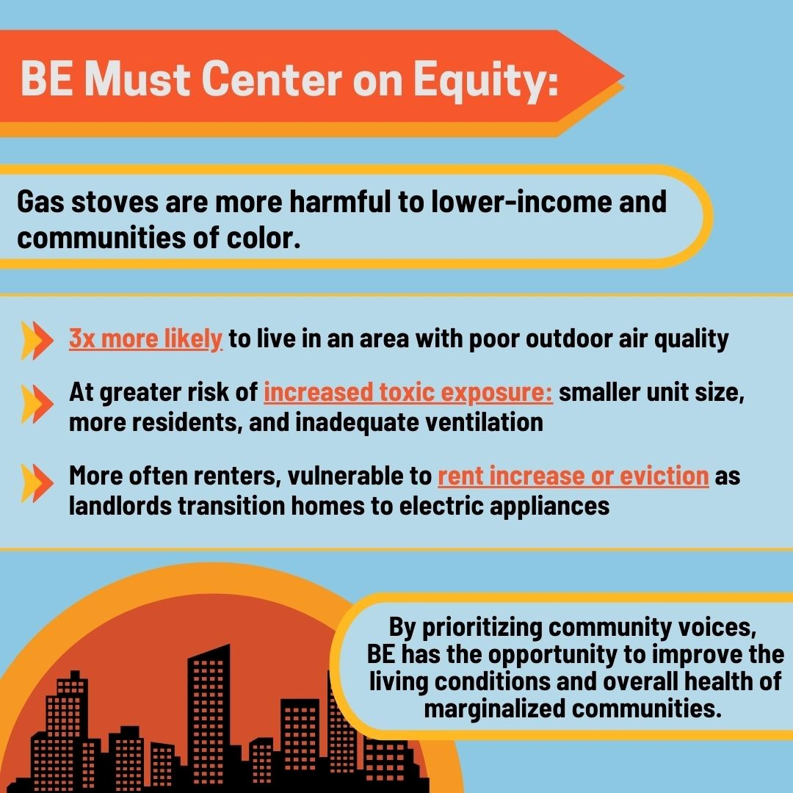
The Health Harms of Gas Stoves
Learn more: www.sfbaypsr.org/BE

